Slide 1
Instrument Design

Slide 2
How to find the optimal geometry of the tool?
Workspace Study
Normal, high quality MRI scan of the middle ear -> 3D model using lab software
Analyze/quantify the workspace volume, and what anatomical obstacles are there (include bones, facial nerve, etc.)
Optimize Tool Design
Start very simple: eg. A straight, rigid instrument, with one curve or one bend
Analyze how it can move in the model
Figure out if pitch, yaw, roll is required
Add more mechanisms based on what is required after this analysis

Slide 3
How to access recesses in the middle ear?
Controlled tool bending
Pre-shape tools to optimized angles/curvatures calculated using 3D ear models

Slide 4
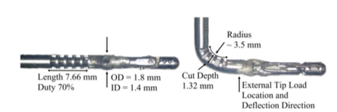
Mechanisms
Concentric Tubes
https://www.youtube.com/watch?v=IUg4Jco-Apc
Push the curved tube out of a straight tube
Can have multiple tubes to widen workspace
Can preshape the curve
Wrist
Requires cable running along the inside of the tube
Problem: slits can become blocked
by tissue
Notes:
- Will concentric tubes work in a semi-wet environment? How well would they slide in the ear surgery environment?

Slide 5
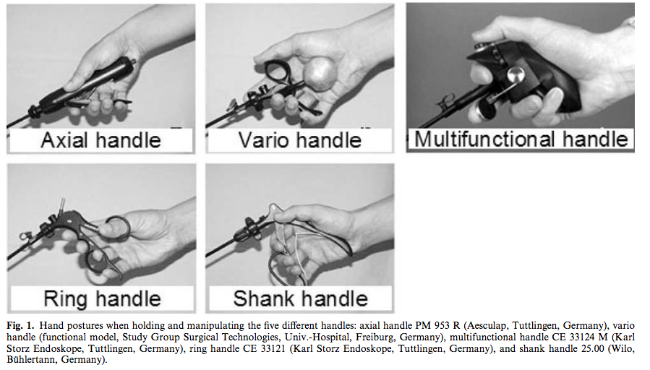
Existing Handle Designs
Requirement: hand/wrist must remain steady during actuation
Fingers gripping the tool must perform the actuation

Slide 6
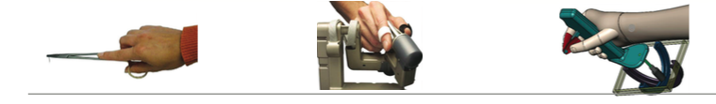
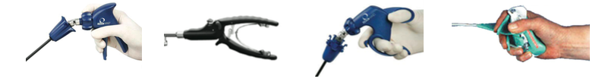

Slide 7
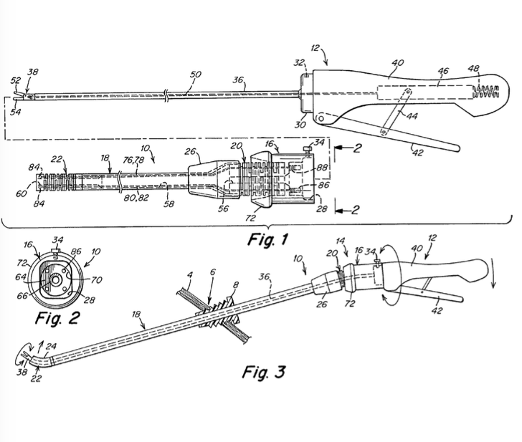
Handle can be modified so the fingers are actuating instead of the whole hand

